Slide 1
Context Relation
Huang Z, Wang X, Huang L, et al. CCNet: Criss-Cross Attention for Semantic Segmentation[J]. arXiv preprint arXiv:1811.11721, 2018.
Fu J, Liu J, Tian H, et al. Dual attention network for scene segmentation[J]. arXiv preprint arXiv:1809.02983, 2018.
Yuan Y, Wang J. Ocnet: Object context network for scene parsing[J]. arXiv preprint arXiv:1809.00916, 2018.
Wang X, Girshick R, Gupta A, et al. Non-local neural networks[C]//Proceedings of the IEEE Conference on Computer Vision and Pattern Recognition. 2018: 7794-7803.

Slide 2
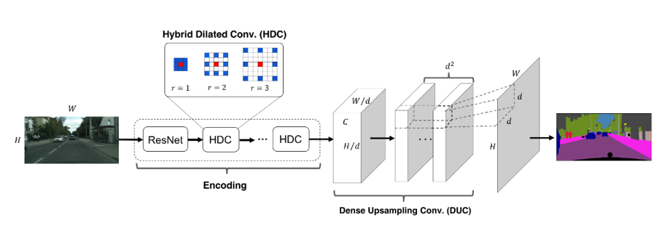
近年来，语义分割的模型几乎都是基于FCN框架，利用Dilated Conv、Up sample、skip connection等各种组件来变化。 但是这种模型有很大的问题：无法对不同的像素之间的关系进行显式的建模，像素之间的唯一联系就是“感受野”的重叠。所以从本质上来说，这种语义分割框架是一种Dense prediction, 是分立的对每个像素进行预测。

Slide 3
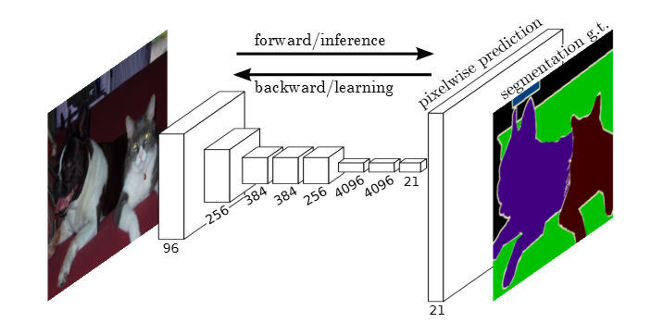
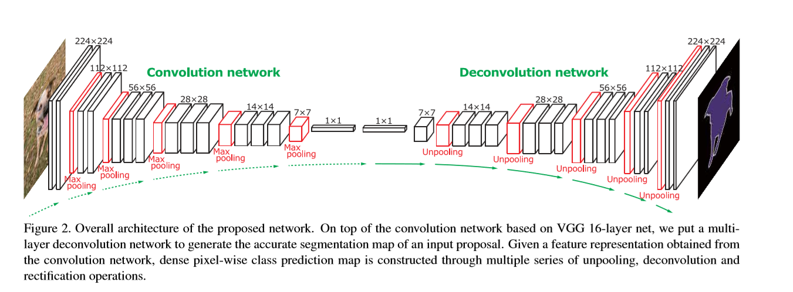
基于FCN的Segmentation框架

Slide 4
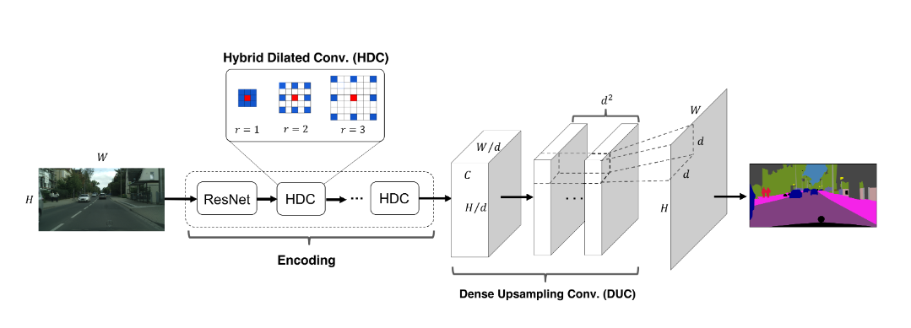
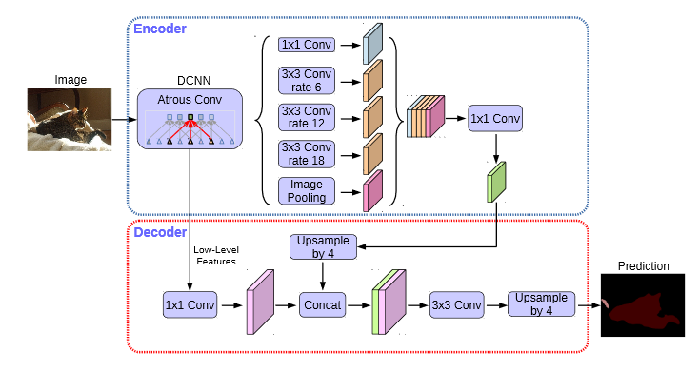

Slide 5
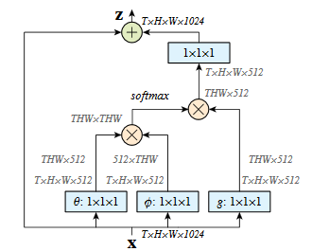
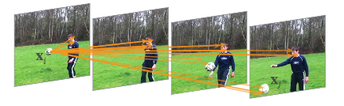
Non-local Neural Networks
Wang X, Girshick R, Gupta A, et al. Non-local neural networks[C]//Proceedings of the IEEE Conference on Computer Vision and Pattern Recognition. 2018: 7794-7803.

Slide 6
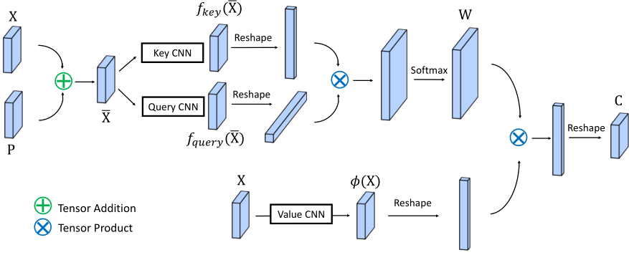
Wang X, Girshick R, Gupta A, et al. Non-local neural networks[C]//Proceedings of the IEEE Conference on Computer Vision and Pattern Recognition. 2018: 7794-7803.

Slide 7
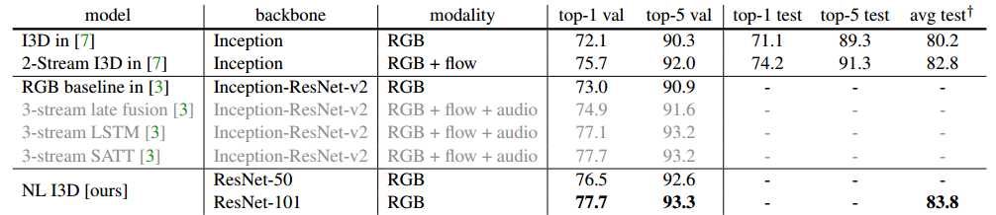
Wang X, Girshick R, Gupta A, et al. Non-local neural networks[C]//Proceedings of the IEEE Conference on Computer Vision and Pattern Recognition. 2018: 7794-7803.

Slide 8
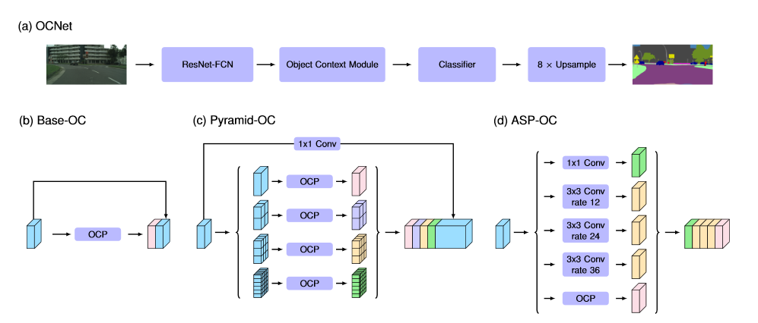
OCNet
Yuan Y, Wang J. Ocnet: Object context network for scene parsing[J]. arXiv preprint arXiv:1809.00916, 2018.

Slide 9
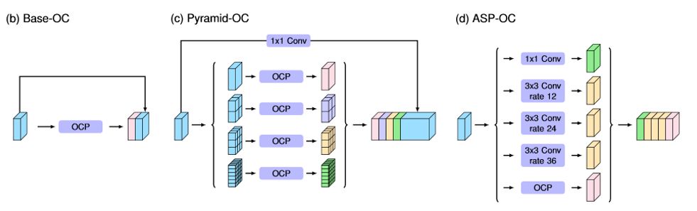
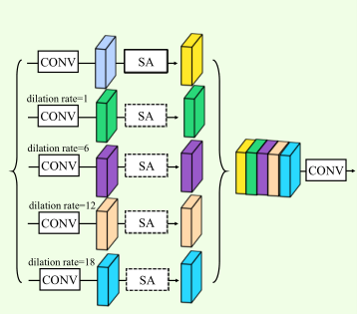
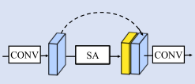
Yuan Y, Wang J. Ocnet: Object context network for scene parsing[J]. arXiv preprint arXiv:1809.00916, 2018.

Slide 10
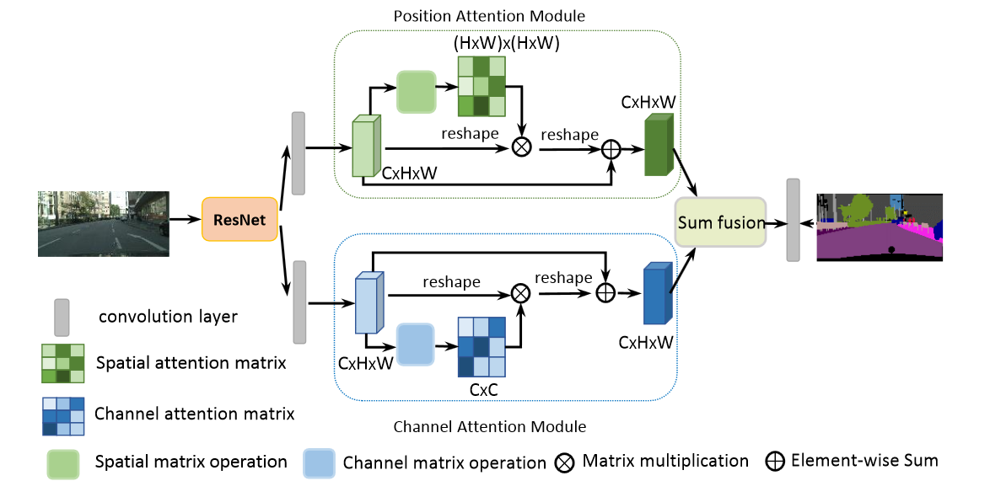
Dual Attention Networks (DANet)
Fu J, Liu J, Tian H, et al. Dual attention network for scene segmentation[J]. arXiv preprint arXiv:1809.02983, 2018.

Slide 11
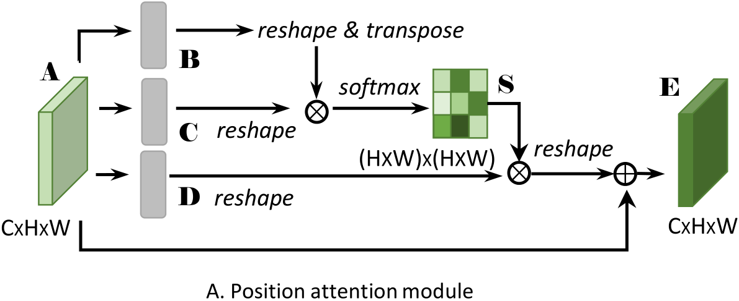
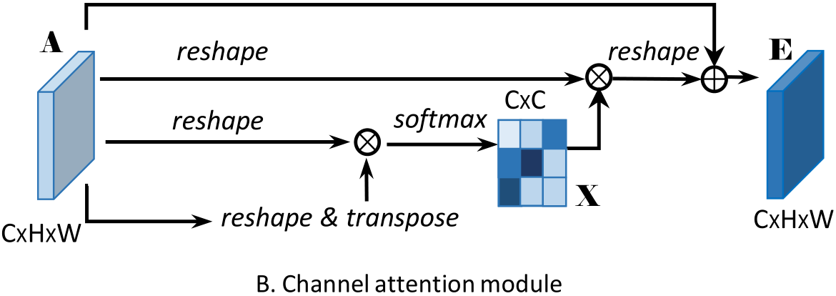
Fu J, Liu J, Tian H, et al. Dual attention network for scene segmentation[J]. arXiv preprint arXiv:1809.02983, 2018.

Slide 12
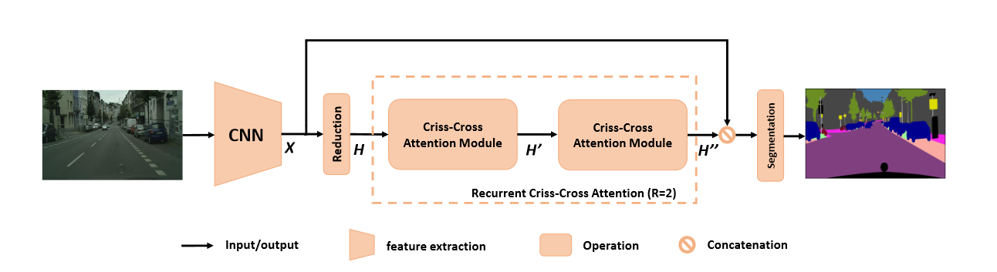
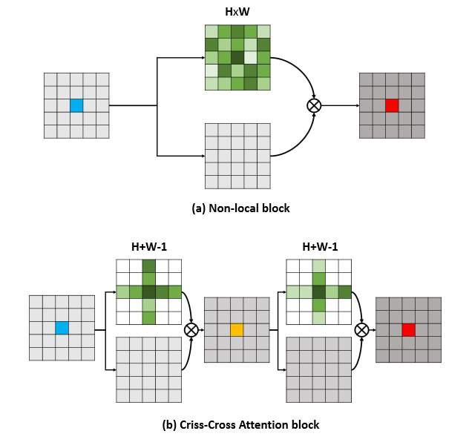
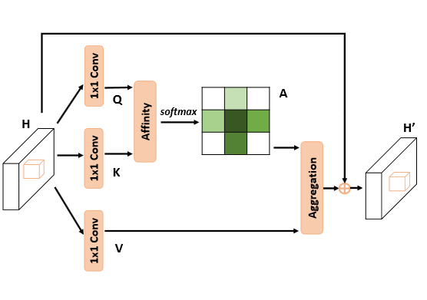
Huang Z, Wang X, Huang L, et al. CCNet: Criss-Cross Attention for Semantic Segmentation[J]. arXiv preprint arXiv:1811.11721, 2018.

Slide 13
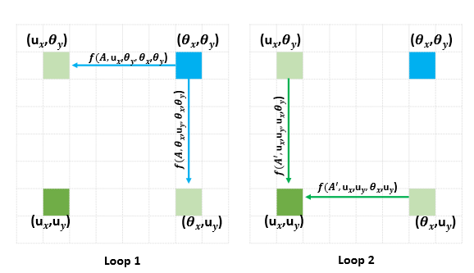
看了CCNet很容易想到为什么不先横向aggregate然后再纵向aggregate其实也可以cover住所有的位置的context，我们认为CCNet是一个不错的工作，但是在对CCNet为什么work的解释方面略微缺乏，尤其是这种十字架的aggregate怎么去解释是不太直观的。
Huang Z, Wang X, Huang L, et al. CCNet: Criss-Cross Attention for Semantic Segmentation[J]. arXiv preprint arXiv:1811.11721, 2018.

Slide 14
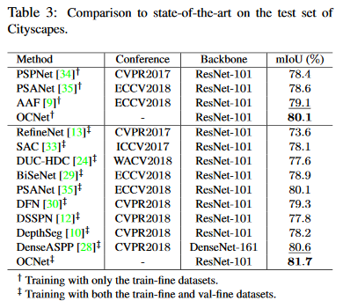
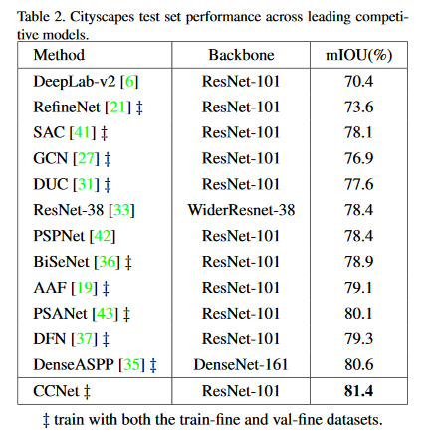
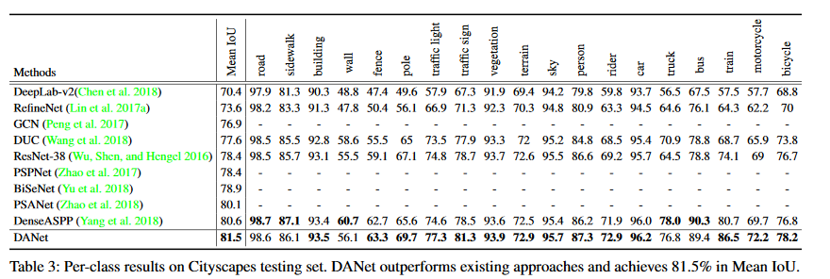

Slide 16
